Slide 1
Accessibility Automation Testing Tool accessbot.io

Slide 2
Agenda
Introduction
Overview of accessbot product
Q&A
Follow Up

Slide 3

accessbot

Slide 4
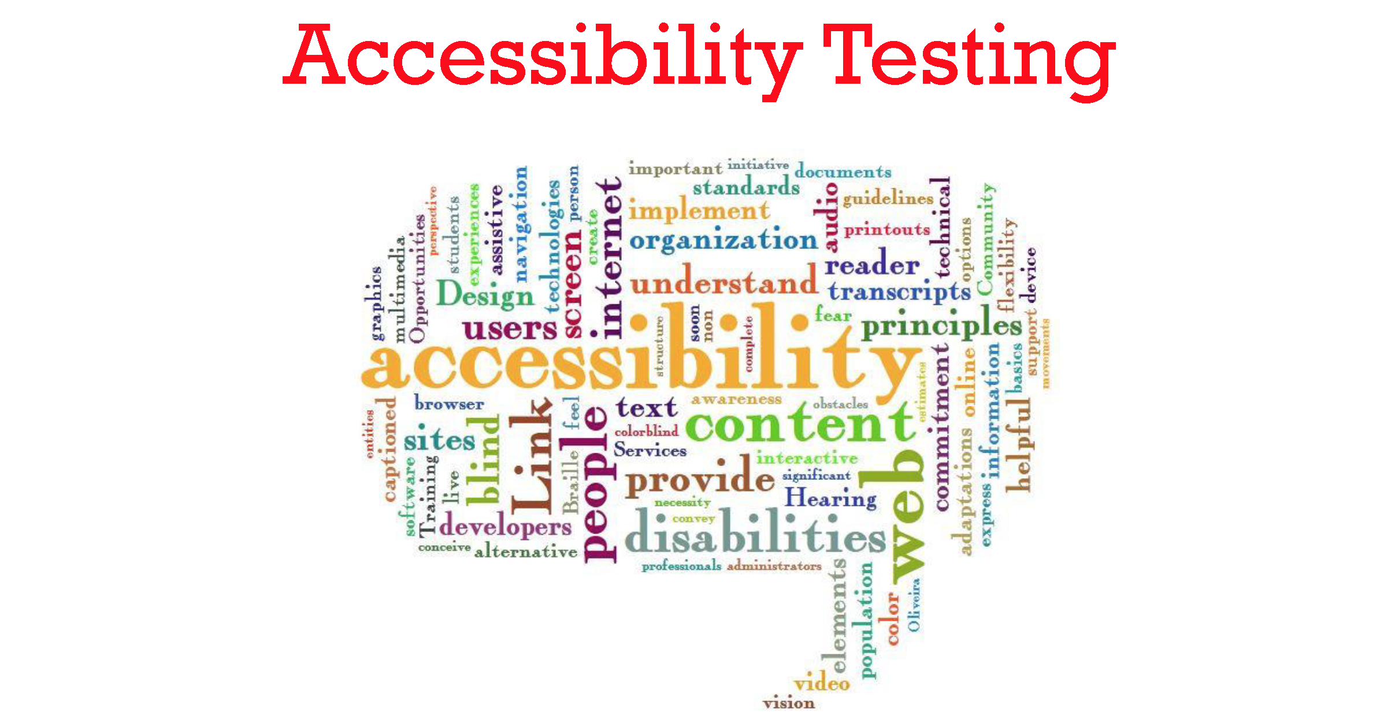

Slide 5
Automated Accessibility Testing
Manual Validation
Automated Validation
Continuous Validation by
1-3 hours for one web page
High cost of remediation
Takes 1-3 hours for complete web application
10x* speed improvement
Medium cost of remediation
Takes 1-3 minutes for complete web application
100x* speed improvement
Low cost of remediation
*for a 100 page web application, only for rules that can be automated

Slide 6
Current Industry Challenges
Cost
Slow testing process increasing costs
Current accessibility testing practices increase costs as testing is conducted too late in the development cycle
Coverage
Reduced coverage due to tight schedules
Accessibility test coverage is almost an after thought, increasing the risk of issues seeping into production
Integration
Lack of integration into development source
Developers cannot get instant feedback into the accessibility issues for the UI developed
Changing Rules
Constantly updating UI/UX Accessibility rules with addition of Mobile devices and other peripherals
Changing rules based on changing technologies
Manually testing the screens and reporting issues for fixing, increases the schedule costs
Accessibility testing coverage is limited most of the time by the tight release schedules
No integration between the modern development environment(MDE) to run tests with CI integration
New technologies causing changes in the way Accessibility rules are implemented and tested

Slide 7

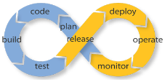

Our Approach
Accelerate accessibility testing with automation
Accessibility testing from early stages of development
Identify and fix WCAG 2.0, Section 508 compliance issues

Slide 8
Mosiac Features
Scan websites for Accessibility issues
WCAG 2.0, Section 508 and ADA Compliance ruleset
Scan dynamic web pages and forms
Configurable rules engine for future changes in compliance guidelines
Configurable Reporting Engine to define priorities
Easy to understand reporting
Web UI Interface and REST APIs
Integration with CI servers and DevOps lifecycle for instant feedback
Rest API calls integration in unit and regression testing
Integration with tools and frameworks such as Selenium, Jmockit, Cucumber, TestNG
Customizing your own rules
Basic Features
Advanced Features

Slide 9
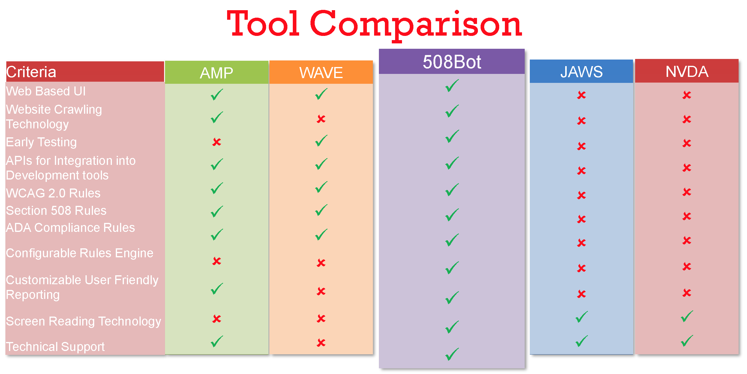
accessbot

Slide 10
Contact Information
Corporate Headquarters
8726 Town and Country Blvd,
Suite #202 Ellicott City MD, 21043
Telephone: +1 443-761-0655
FAX: + 1 443-288-2222
E-mail: info@valsatechcorp.com

